Slide 1
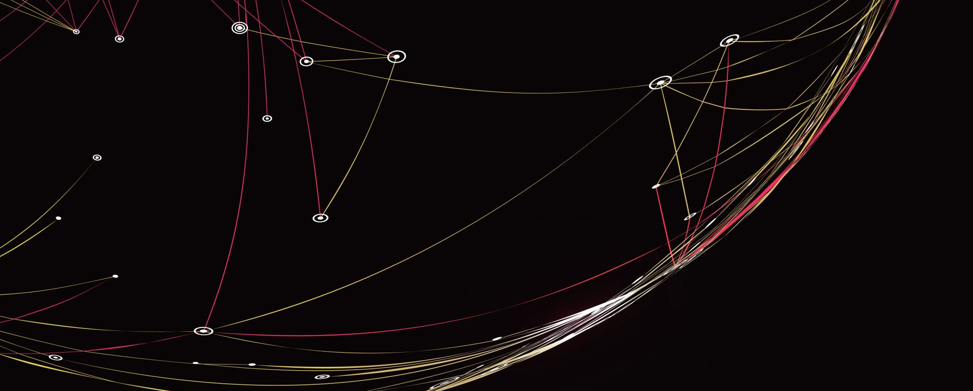
Solution Architecture Diagram
AWS Serverless architecture

Slide 2





AWS Serverless Architecture
AWS Cloud
(API Function Invokes Lambda)
Users
Amazon API Gateway
AWS Lambda
Amazon DynamoDB
(Performs CRUD operations on Dynamo DB Database)
2

